Slide 1
Medico
A Web Application For Detecting Human Diseases Using Machine Learning

Slide 2
Supervised By
Presented By
Md. Mustafizur Rahman
Assistant Professor
Department of CSE
Dhaka City College
Mabia Sultana Shila
Reg No: 16502000450
Kamrun Nahar Tania
Reg No: 16502000404
Nazmun Nahar Nezum
Reg No: 16502000460
Medico

Slide 3
Outlines
Abstract
Existing Systems
Limitations of Existing Systems
Proposed System
Features
Software Requirements
Technology Used
Flowchart
E-R Diagram
Use Case
Use Case Diagram
UI Design
Implementation
Future Work
Medico
01

Slide 4

Abstract
According to research, there are 40% of people who ignore the general disease which leads to harmful disease later. The main reason for ignorance is laziness to consult a doctor which later results in fatal disease. According to research, 25% of people face death due to early ignorance. So we propose to develop this web application that users can use sitting at their convenient place and have a checkup of their health.
Medico
02

Slide 5
Existing Systems
In existing systems, prediction is done based on the tests. Prediction using traditional methods involves various measures of algorithms such as datasets and much more to add on.
Medico
03

Slide 6
Limitations of Existing Systems
Detection is not possible without diagnosis
Time consuming
Patients need to pay for diagnosis
Need Physical attention
Medico
04

Slide 7
Proposed System
The proposed system is a web application that allows users to get instant guidance on their health issues. The system allows users to share their symptoms and issues. Then the system processes user’s symptoms to check for various illnesses that could be associated with it. For accurate result, we have prepare a dataset for specific diseases. Then the dataset is trained well to predict a disease with a great percentage of accuracy.
Medico
05

Slide 8
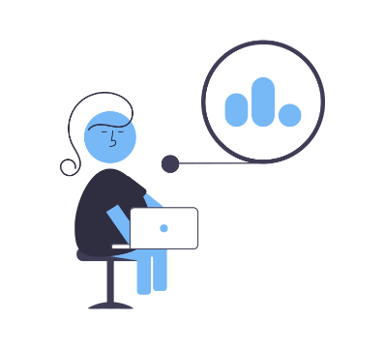

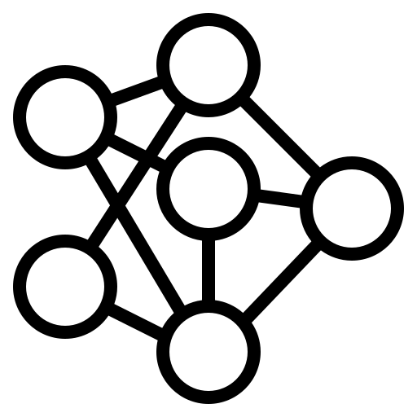
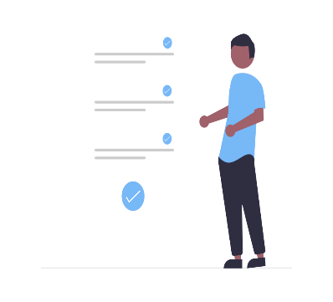

Features
Users can check for diseases by giving symptoms
Machine Learning for accurate disease prediction
Users can view list of recommended doctors
Users can rate doctors for their consultation
Medico
06

Slide 9
Software Requirements
Front End : HTML, CSS, JavaScript
Back End : Python, C#
Database : MySql
Tools : Visual Studio Code, Pycharm IDE
Medico
07

Slide 10
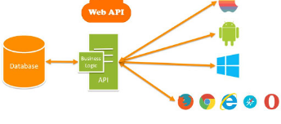
Technology Used
There are Two servers - One for UI and another for machine learning.
Both of them are created using Web API Technology.

Slide 11
Flow Chart
Start
Input
(Symptoms)
Disease Prediction
Model
Predicted Result
Yes
if accuracy < 50
No
List of Doctors
End
Medico
08

Slide 12
E-R Diagram
id
name
address
id
name
phone no
view
PDoctor
institute
PPatient
ratings
gives
get
has
rating
PRatings
doctor id
patient id
PAddress
PSpeciality
doctor_id
address
phone_no
email
name
experience
Medico
09

Slide 13
Use Case
The user need to register and login first.
After giving their symptoms to the system will automatically predict disease.
Then The recommended doctor list will be shown.
From the details doctor section patient can check doctor’s name, address, ratings.
Patient can choose doctor as per his/her requirements.
Medico
10

Slide 14
Use Case Diagram
Register/
login
Check Disease
View Doctors
Rate
Patient
Doctor
Medico
11

Slide 15
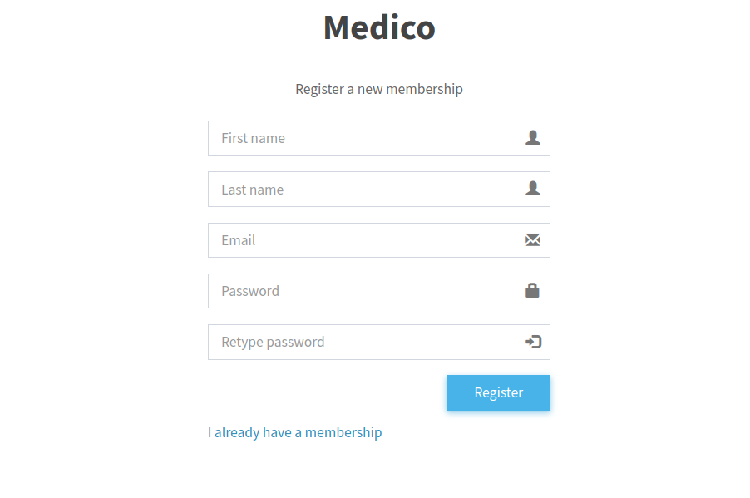
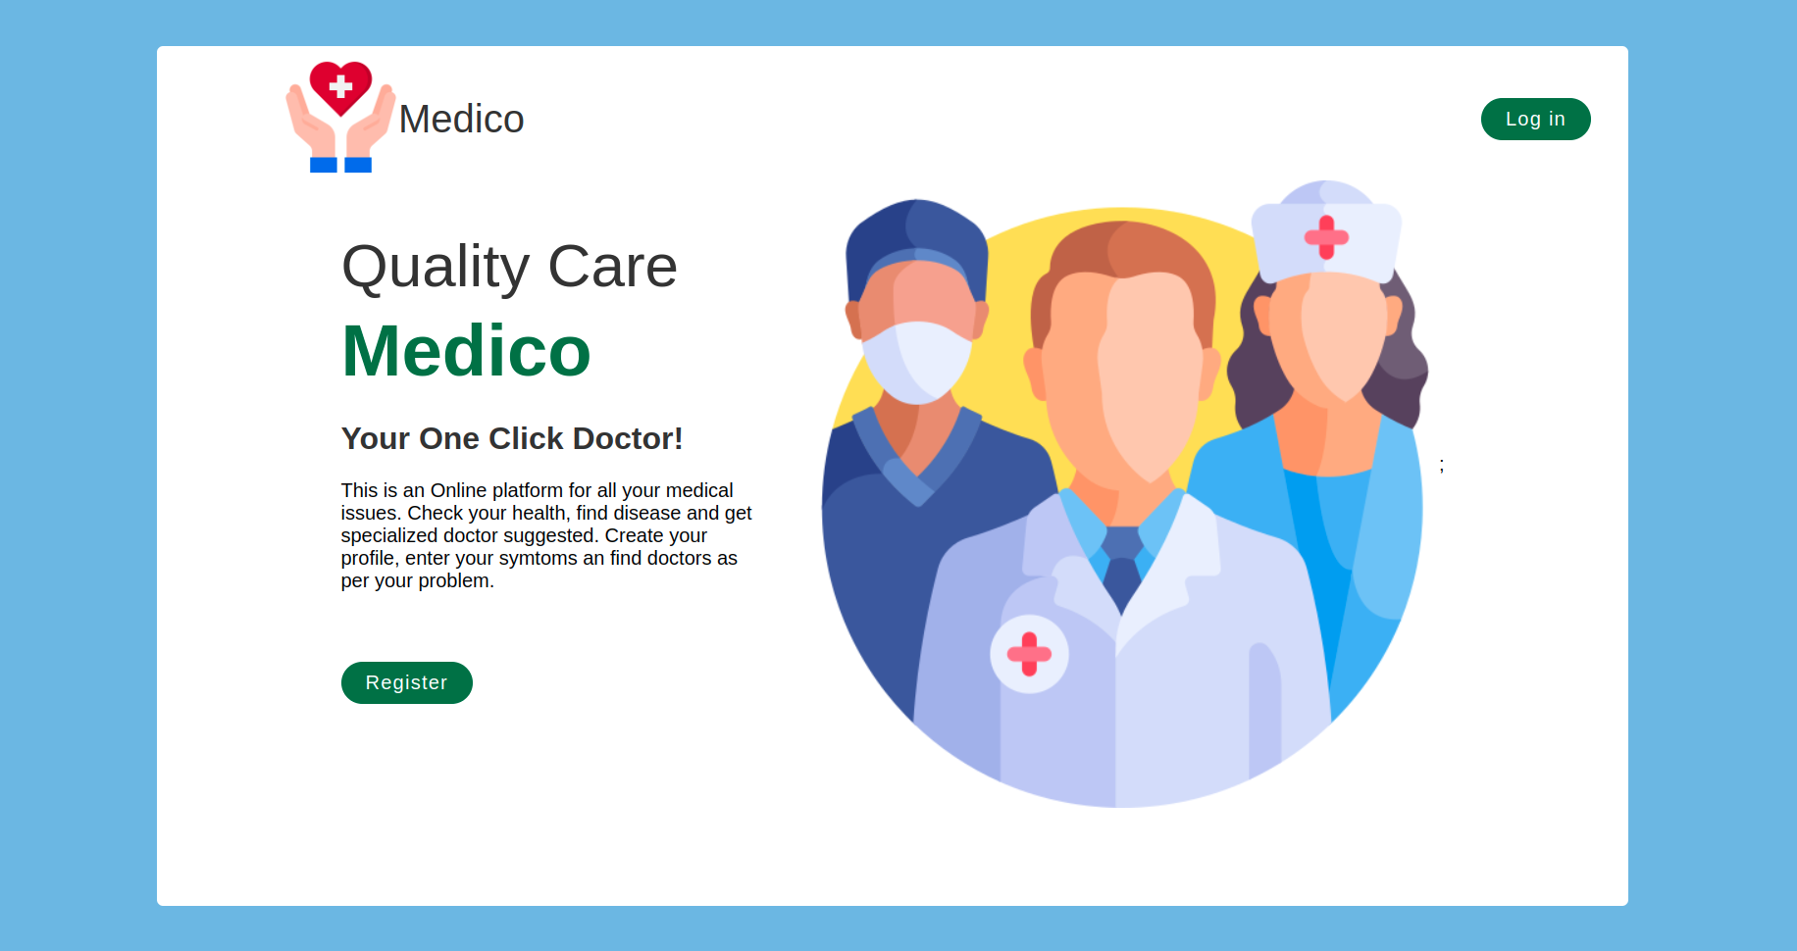
UI Design
Landing Page
Sign Up Page
Medico
12

Slide 16
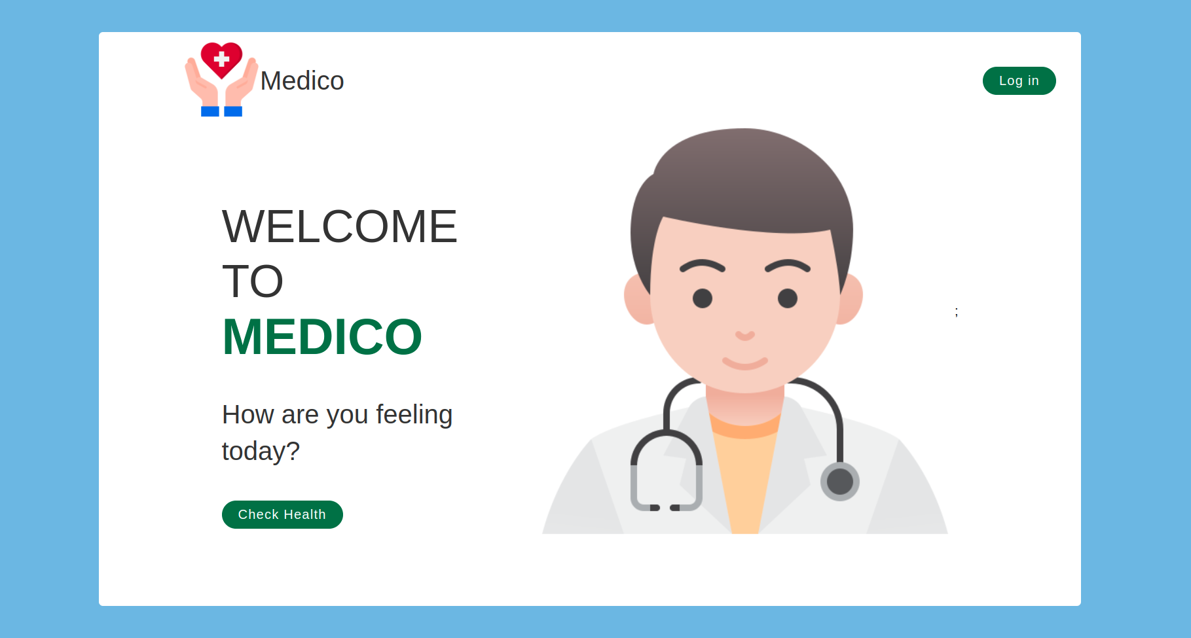
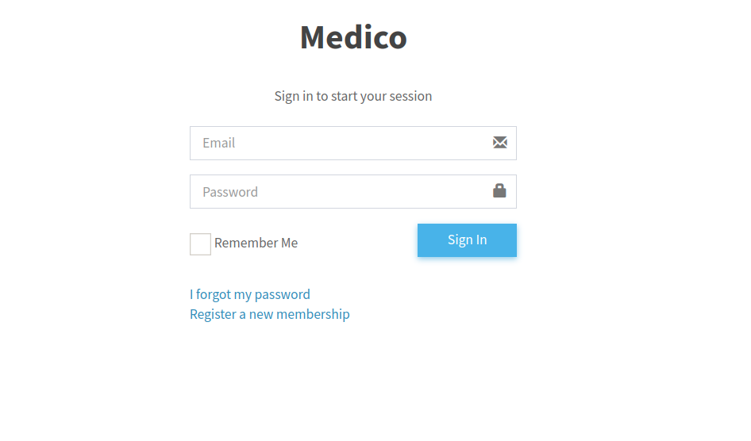
UI Design
Sign In Page
Dashboard Page
Medico
13

Slide 17
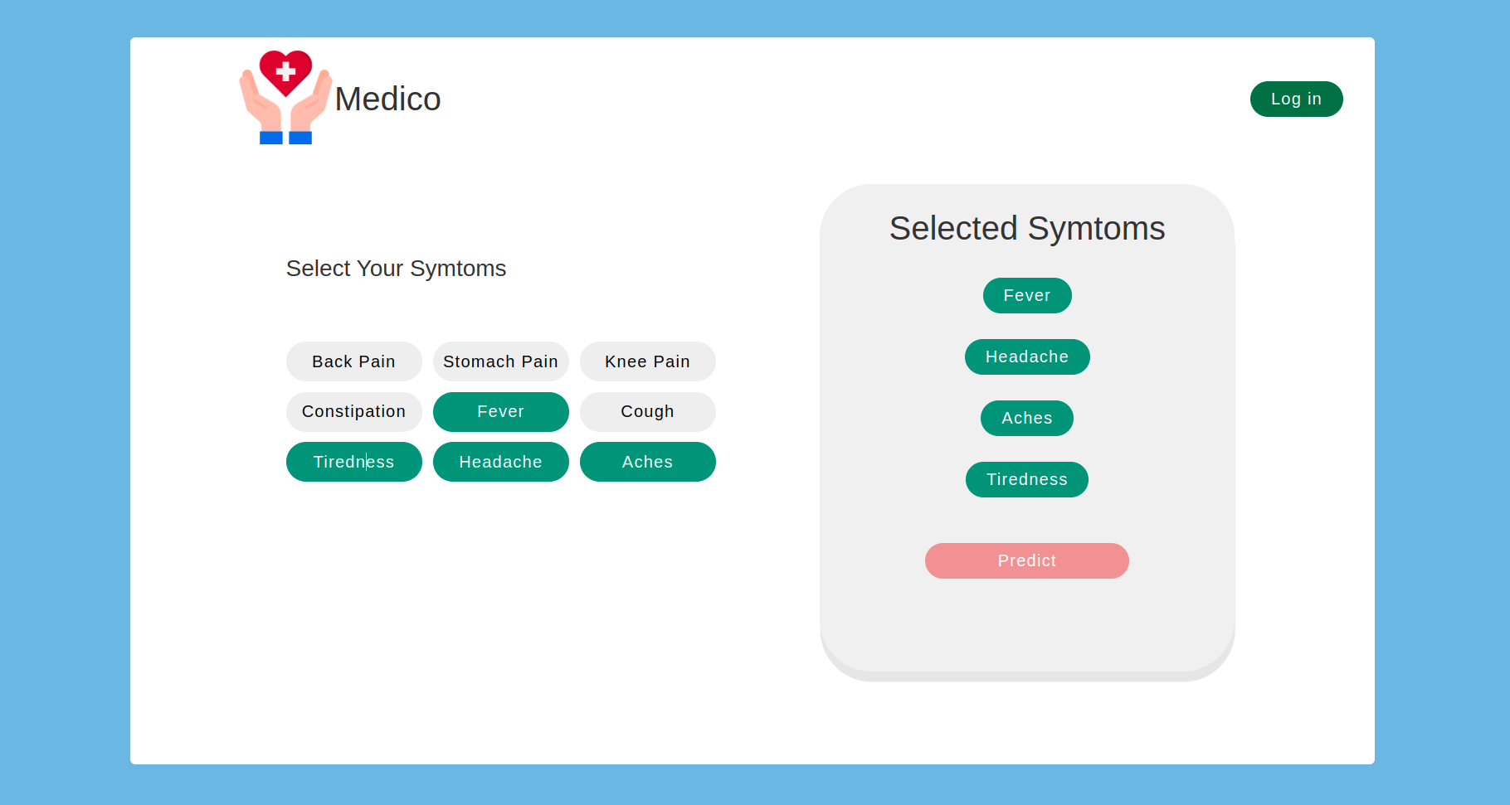
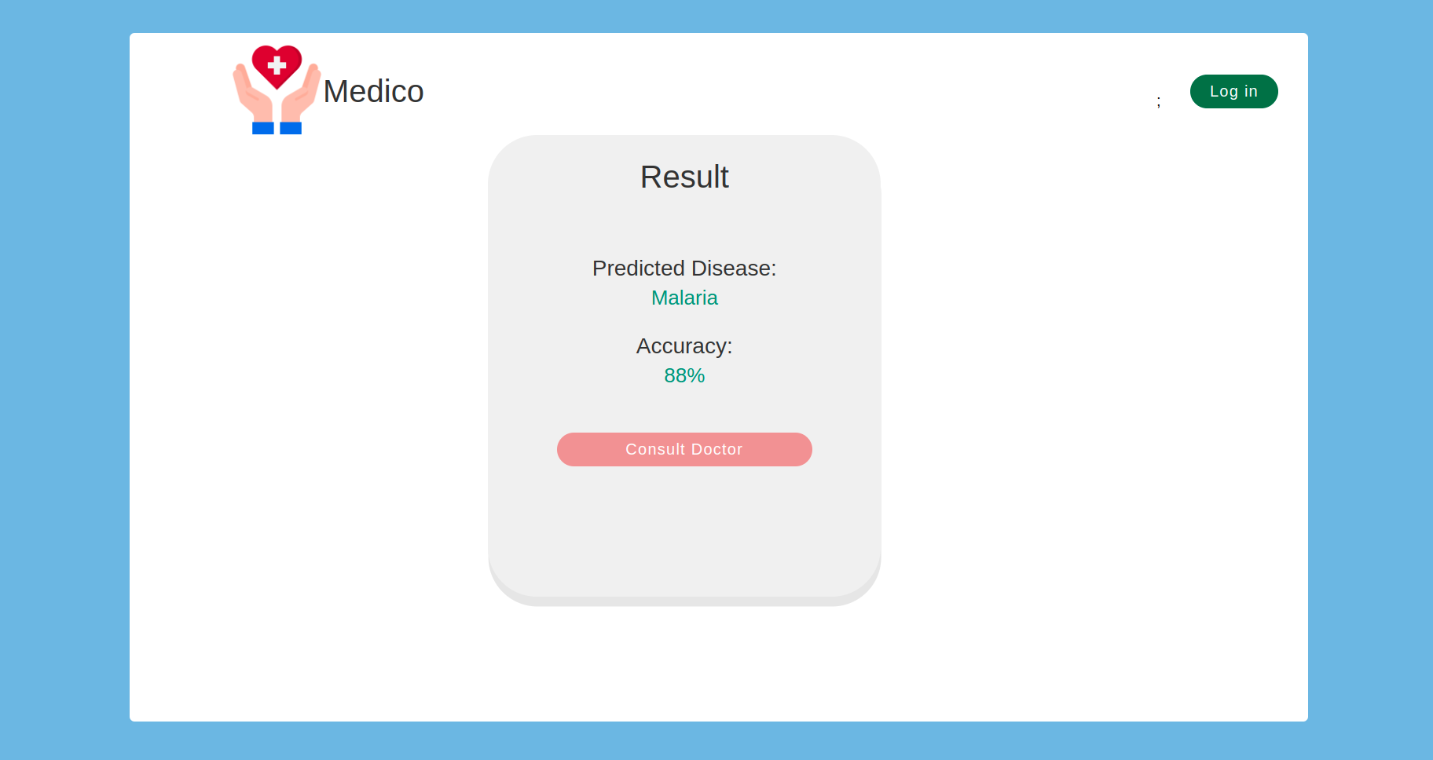
UI Design
Add Symptoms Page
Result Page
Medico
14

Slide 18
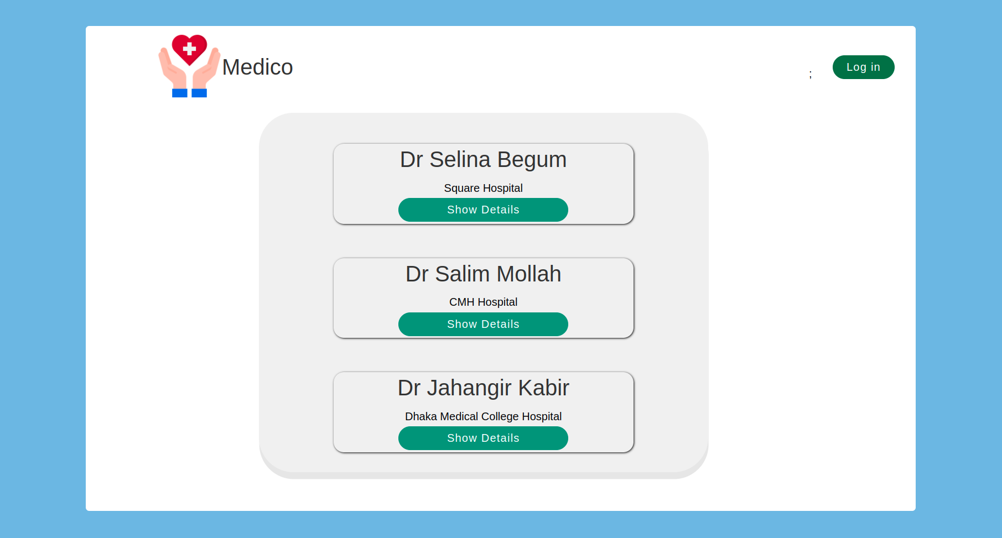
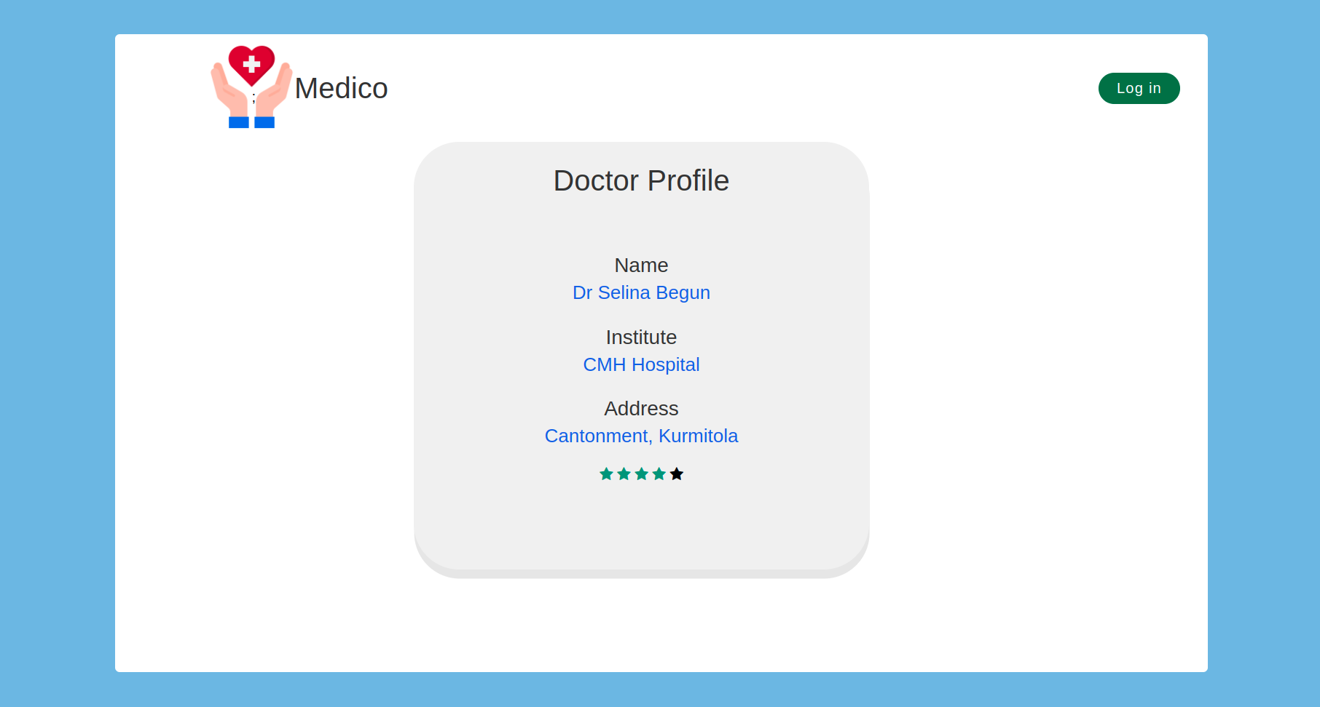
UI Design
Doctors List Page
Doctors Profile Page
Medico
15

Slide 19
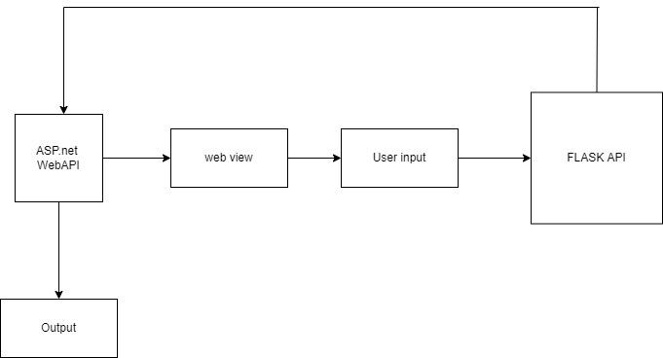
Implementation
The user will login or register
Then they will input their symtoms
Input data will go to the flask server
flask server will process those data
and will predict a disease by using
machine learning algorithms.
Then the final result will be shown
in the web view.
Fig: Workflow Diagram
Medico
16

Slide 20
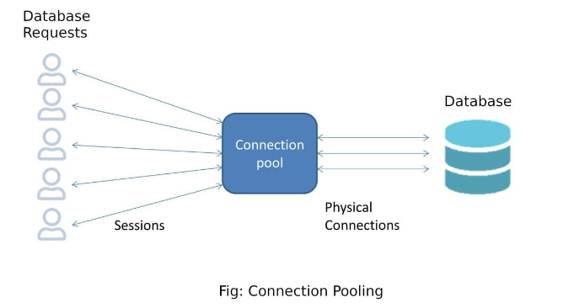
Implementation
MySql : To reduce connecting and disconnecting overhead a connection pooling mechanism has been implemented.
Medico
17

Slide 21
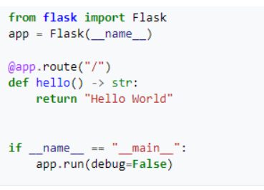
Implementation
Flask and Machine Learning: Flask is a micro web framework written in Python. It is classified as a microframework because it does not require particular tools or libraries. It has no database abstraction layer, form validation, or any other components where pre-existing third-party libraries provide common functions.
Medico
18

Slide 22
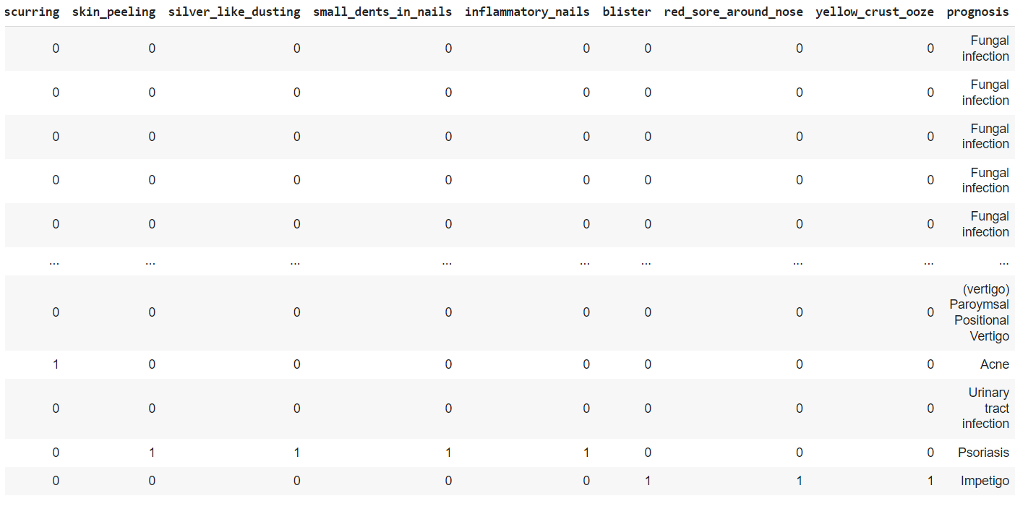
Implementation
The training dataset has about 5000 of diseases and each disease has 133 possible symtoms. Training dataset’s first 14 rows are shown below:
Medico
19

Slide 23
Implementation
For machine learning we have used several algorithms and libraries to achieve our goal.
(i) Pandas
(ii) Scikit-Learn
(iii) MultinomialNB
Medico
20

Slide 24
Future Work
In Future, we will integrate video chatting
We will make our dataset more enrich for higher prediction rate
More Precise doctor verification system
Medical Document server system
Location of doctor’s chamber, Hospital or clinic
Medico
21

Slide 25
Thank You

